Slide 1

Aromatic Analytics
Decoding the DNA of best seller perfumes
est. 1987
Aditya Sindhavad | Adithya Murali | Advaith Shankar
Manasa Maganti | Shashank Rao | Varsha Manju Jayakumar
Notes:
Our project, Aromatic Analytics, is all about using data to figure out what makes a fragrance stand out—by looking at the notes people love, the reviews they trust, and the patterns that make a best-seller. We’re taking the guesswork out of the perfume industry and helping brands match the right scents to the right people. Let’s dive into how we’re doing it!

Slide 2
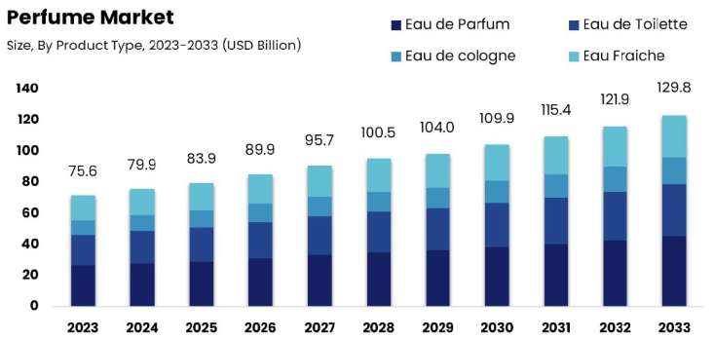
Predict best seller - but why is it important to solve?
Believe it or not, a staggering 773 million people worldwide now rely on online platforms to find their perfect scent.
Websites can position their product rightly that matches with user’s notes and preferences
Notes:
Significance of the Problem
With 773 million people worldwide relying on online platforms to discover their perfect scent, brands need more than just good marketing—they need to understand what consumers really want. Perfume is a deeply personal choice, and brands that can align their products with users' preferences are more likely to succeed. This project aims to help brands better understand consumer sentiment and position their fragrances in ways that resonate on a sensory level, ultimately increasing the chances of creating a best-seller.
Project Objective
We’re focusing on predicting which newly released perfumes could become best-sellers. By analyzing what makes current best-sellers stand out, we aim to identify the attributes that consistently appeal to consumers. This approach allows us to provide brands with actionable insights, helping them refine product offerings based on data-driven predictions, not just intuition.

Slide 3
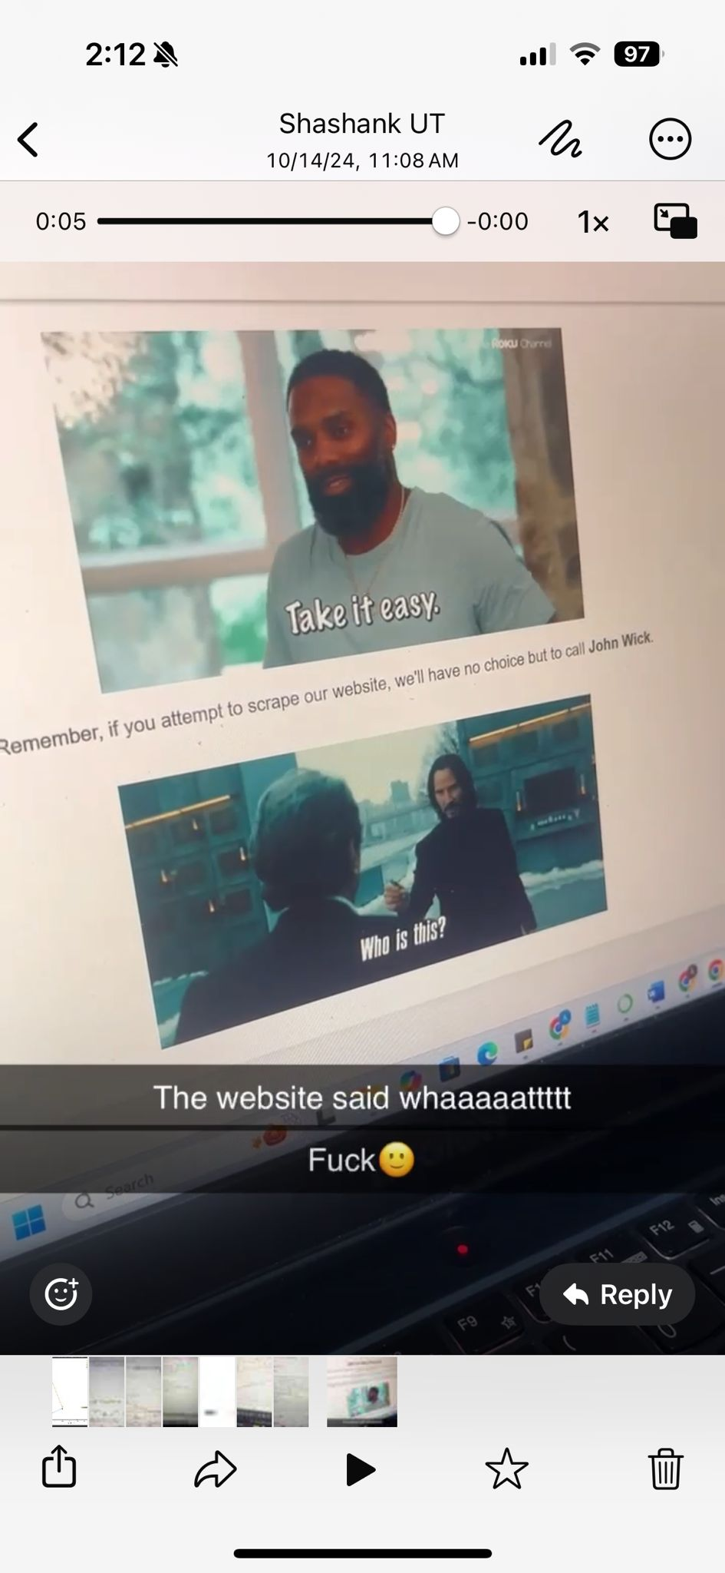
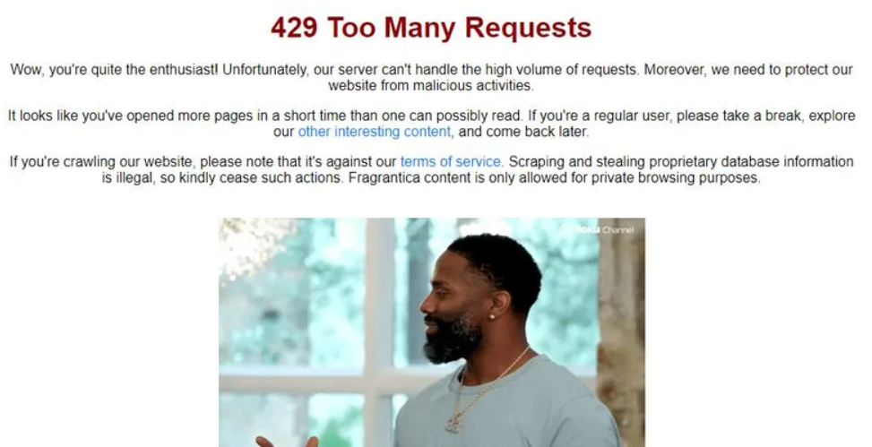
Data Sources & Scraping info
The John Wick moment
Scraped user reviews for -
Train set: top 60 best seller and bottom 60 perfumes (identifying the key attributes using their user reviews)
Test set: 30 newly released perfumes (predicting which of these would be best sellers)
Notes:
Scraping the Fragrantica Website
Issues: Website Speed and Loading Behavior
The target website was extremely slow, especially in loading user comments.
User comments were located at the bottom of the page, requiring scrolling for them to load.
Delay of 6 seconds per product/perfume was observed for comments to appear, affecting scraping efficiency.
Initial Approach: Scrolling to Load Comments
To resolve the issue, we created a scroller that navigated to the bottom of the page.
However, this approach only loaded the first 5 comments.
To load more comments, we needed to interact with the page further.
Updated Scrolling Method:
The scroller was enhanced to:
First go to the bottom of the page.
Then scroll 300 units upwards with a single scroll.
This allowed us to automate the process of loading additional comments.
New Challenge: Blocking Mechanisms
After scraping two products/perfumes, the website’s anti-scraping measures kicked in:
Reviews stopped loading after two product pages.
CAPTCHAs were introduced by the website.
Scrolling restrictions appeared with a “John Wick meme” indicating we were blocked and can’t scroll further browse the website.
Observation: User-Like Behavior Improves Loading
While manually browsing the site, we noticed that comments loaded correctly when scrolling slowly and at random intervals.
This behavior mimicked real user actions and avoided triggering anti-scraping mechanisms.
Solution: Randomized Scrolling Behavior
To imitate natural user behavior, we introduced two random variables:
Scroll distance: Randomized between 300 to 700 units.
Time interval: Randomized delays between scrolls from 1 sec to 4secs
This combination allowed us to:
Continue scraping without being blocked.
Successfully retrieve up to 250 user reviews per product.
Outcome:
By implementing a randomized scroll pattern, we were able to bypass the website’s anti-scraping defenses.
The updated method ensured efficient scraping without triggering CAPTCHAs or getting blocked.

Slide 4

Analytics on the data - Pulling out notes of a perfume
Corpus of Information
Top 60 products based on professional reviews
Sentiment analysis on product reviews for each product
Discard product(s) with bad aggregated sentiment score
Named entity recognition (NER) on each review
Cluttered insights from topic modelling
Topic Modelling using LDA
Perform coherence score calculation to see ideal topic numbers
Entities recovered for each review
Seperate all entities and create list
Clean list
Write to separate CSV file
Done using GPT
Perform word count to get top notes from reviews
Group with respect to root word
Perform lemmatization for root word
Discard entities which have nothing to do with perfumes
Ranking done to give most weightage to most frequently mentioned notes
Similarly done for extracting notes of bad perfumes..
Notes:
Our goal here is to find the notes which make or break a perfume by analyzing reviews for a particular perfume since this will be one of the most important characteristics to decide whether a perfume will be a hit or a miss when launched. We started of our analysis with this goal and almost brute forced our way into finding the optimal way to do it. The above is a flow chart for the optimal way on how we went about this. I will detail out the results we observed from each major step on the chart.
We decided to take the top 60 products and analyze the reviews for each of these products. Each product had multiple reviews (in range of 100s) which were analyzed.
It occurred to us that although a product might be rated well on the website, it does not mean it is popular among the masses. Hence, we performed sentiment analysis on all the reviews by grouping it with each product.
We took the aggregate of these sentiments per perfume by taking the mean. If the sentiment was negative for a product based on the reviews, we discarded this product from the observation.
The next goal was to pull out the scent notes for each product from its corresponding reviews. Our first instinct was to perform topic modeling but since we are not perfume experts, we did not really know how many topics can this be divided into, hence we performed a coherence score calculation and found that the coherence scores vs topics was the highest for 3 topics, 7 topics and 11 topics. We were a bit skeptical about this but we still went ahead and performed topic modelling
When we performed topic modelling with all the above mentioned observations we did not really gain any good insights.. For some reason, the topics weren’t making much sense and we decided we needed to go about another route. Hence we did more research online and found Named Entity Recognition is a good alternative.
We performed NER using the 'en_core_web_sm' which is a small sized pre trained English Language Model. When we performed NER on each review, the attributes getting pulled were making sense and I was also able to manually see the scent notes coming up this time from a majority of the reviews.
After pulling out the entities for each review, they were separated (They were comma separated and hence a simple split by comma worked) and put into another list.
This list was cleaned by making everything lowercase, removing any unnecessary punctuations etc.
We decided to perform lemmatization to group scent notes which were the same but were worded differently as a single entity. For example, woody was treated as a separate entity and wood was treated as a separate entity. Running a word counter on this wasn’t ideal. We tried doing lemmatization on python using spacy but the results weren’t satisfactory.
Since we are in the time of generative AI, I decided, GPT can do a far superior job in this. Hence, we exported the list to a csv file
After exporting it to a csv file it was prompted into GPT and was asked to discard entities which had nothing to do with perfumes or its characteristics.
After getting the cleaned up file, GPT was prompted to perform lemmatization but with another column where I could manually check if it was doing a good job and not surprisingly it was!
The one place although GPT faltered and was needed multiple promptings were to group the entities with the same root words and to be counted. This was surprising, so I’m not sure why this happened but after multiple checks and prompts it was able to give me the final list with the scent note and the number of times it had appeared.
After downloading the csv file back from GPT, it was read using pandas on python and a simple ranking mechanism was created.
We considered only the top 10 notes for computational simplicity and also because the word frequency count after the 10th note started to drop drastically. The most frequently appearing scent note was given a higher weightage (higher number) and a dictionary was created. This dictionary is later used for cross checking against the test set to assign a part of the evaluation score.
The above was done for the top 60 perfumes but the exact same process flow was followed for the bottom 60 perfumes (except, the topic modelling bit since it wasn’t being very helpful to us)
Additional Note: ‘Accords’ and ‘Scent notes’ are used interchangeably. In the further slides, scent notes are called Accords.

Slide 5
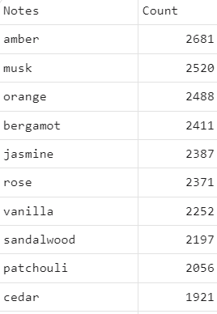
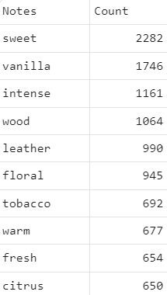
Vanilla is hated as much it is loved - here’s why it
makes “scents”
Vanilla in combination with feminine notes show a positive sentiment, and in combination with masculine notes shows negative sentiment
Bottom Notes
Top Notes
Review of 9pm Afnan cologne - Men’s Fragrance
“Bubblegum candy vanilla scent. Not suitable for 25+ guy. I really like it but I'm too old for it and don't want to smell like a kid. I wouldn't be able to take seriously a person wearing it.”
Review of Coco Eau de Parfum Chanel - Women’s Fragrance
“I have been wearing Coco since I was 23, it is timeless and doesn't represent an age, it exudes confidence, agency, and soft power. Unapologetic, two sprays last all day, and it envelops into a plush, warm, spicy vanilla. So feminine, sensual, intelligent, it is a perfume that represents success to me.”
Notes:
This slide provides insights into the complex perception of vanilla as a fragrance note. Here's a breakdown of the key points:
1. Headline: "Vanilla is hated as much as it is loved – here's why it makes 'scents'."
- This suggests that vanilla in fragrances triggers a divided response: some love it, while others dislike it.
2. Main Insight:
- Vanilla's perception is influenced by its combination with other fragrance notes.
- **Positive Sentiment**: When vanilla is paired with **feminine** notes, it generally results in a positive reception.
- **Negative Sentiment**: However, when combined with **masculine** notes, the sentiment tends to be more negative.
3. Tables:
- The left table shows different fragrance notes and how frequently they appear in perfumes:
- **Bottom Notes (left)**: Vanilla ranks as a popular bottom note (base note), appearing 2252 times.
- **Top Notes (right)**: Vanilla also appears as a top note (1746 times), though less frequently than "sweet" or "wood" notes.
- Key point: Vanilla is often paired with both sweet and woody notes, but its perception changes based on the context.
4. Fragrance Reviews (Supporting Evidence):
Men’s Fragrance:
- The review describes a "bubblegum candy vanilla scent," which the reviewer associates with youthfulness and immaturity.
- The negative sentiment here suggests vanilla is seen as inappropriate or unfit for a mature, masculine fragrance.
Women’s fragrance:
- In contrast, the reviewer describes the fragrance as timeless, representing confidence and intelligence, with the "spicy vanilla" contributing to a plush, warm scent.
- This reflects the positive perception of vanilla in a more feminine fragrance.

Slide 6
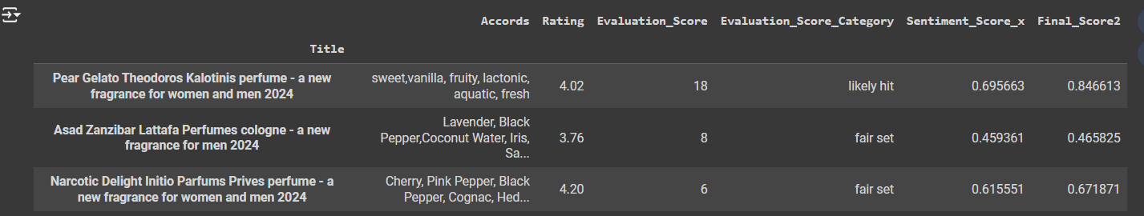
Ranking Fragrances: A Data-Driven Approach to Evaluation
Evaluation score = rank of positive accord - rank of negative accord + 0 for unknown accord
Final score = normalized_sentiment * 0.2 + normalized_rating * 0.3 + normalized_evaluation * 0.5
Evaluation score is calculated based on the balance of positive and negative accords
Final score is determined through a weighted combination of sentiment, rating, and evaluation score to ensure robust analysis
Fragrances are categorized from "Masterstroke" to "Not Fitting" based on their Eval score:
Masterstroke
Likely hit
Fair set
Low attribute match
Not fitting
Notes:
Finally we can track via 2 metrics which are the evaluation_score and the Final_score
First, We have two set of attributes which are the top best accords from the present ‘hit’ perfumes and the worst accords from the user reviews and sentiments from the entire corpus.
We have ranked these scores based on frequency and the sentiments for each .##
Now, the evaluation score is calculated by the sum of ranks of the accords present in the perfume for example if the fragrance has, sweet, amber and orange. the sum of these will be something like +7 - 8 - 9 there having a total evaluation score of -10 indicating the it contain more of the accords associated negatively.
To make these easy to identify we have added these into 5 different bins being Masterstroke Likely hit , Fair set, Low attribute match and Not fitting with evaluation score ranging anywhere between -30 to +30.
But, this alone would not be sufficient to recommend as a hit or not.
To further enhance the recommendation we have clubbed a few more metrics being the user review sentiment score, Avg rating on website and the accord evaluation score. These together give us the final score.
To calculate the final score we have takes the sum of the normalized score of each sentiment score, Avg rating and the accord evaluation score.
So the recommendation can be read as “Pear Gelato” is going to be a likely hit with a high score of 84

Slide 7
Future work and scope
With additional data
Utilize more geographic, demographic, psychographic data to understand the sentiment associated with various attributes
Further project enhancements
Trend Forecasting: Incorporate global and regional market trends, seasonality, and user reviews to forecast which fragrance notes and compositions will dominate future best-seller lists
For example, a perfume brand noticed an uptick in positive sentiment towards floral notes on social media before launching a successful jasmine-based fragrance line
Sustainability and Ingredient Preferences: Expand the analysis to include consumer preferences for eco-friendly and sustainable ingredients, as there is a growing demand for transparency in the perfume industry. This can help brands align with ethical consumer trends.
Notes:
Going forward, this project could achieve even deeper insights by incorporating additional data such as geographic, demographic, and psychographic variables. This would allow us to understand not just the overall sentiment but how preferences shift across different regions, cultures, and consumer groups.
For example, by analyzing these new datasets, brands could identify regional differences in fragrance preferences—one region favoring citrus notes, while another prefers muskier tones. This would enable highly targeted product development and marketing strategies, maximizing engagement with specific audiences.
Another exciting enhancement would be trend forecasting. By integrating market trends, seasonality, and user-generated reviews, we could predict the fragrance compositions that are likely to dominate the market. A brand might observe increasing positive sentiment towards floral notes on social media, using this insight to launch a jasmine-based fragrance that quickly becomes a bestseller."
Additionally, there is a growing demand for sustainable and eco-friendly ingredients. Expanding the analysis to include consumer sentiment around sustainability could help brands align with this trend. By responding to ethical consumer preferences and offering transparency in ingredient sourcing, brands could position themselves as leaders in sustainable luxury, appealing to both eco-conscious and premium consumers alike.

Slide 8
Questions?

